Slide 1
ZeekFlow: Network Anomaly Detection Tool
Infili Technologies S.A.
Athens, Greece 2025

Slide 2
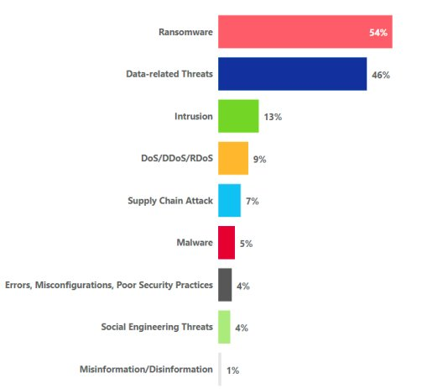
Challenges & Objectives
ZeekFlow: Network Anomaly Detection
Infili Technologies S.A.
Threats in healthcare sector (01/2021 - 03/2023)​
Challenges
44% data related threats
Ransomware: 54% of performed attacks in healthcare ecosystems due to increased value of electronic records
DoS attacks: downtime, energy harvesting, operational interference w/ critical monitoring applications
Malware: host infection from various malicious sources such as botnets, trojans, etc.
Objectives
Detect anomalous behaviors in network traffic with high accuracy
Enable real-time monitoring of connected medical devices
Provide actionable alerts for security personnel

Slide 3
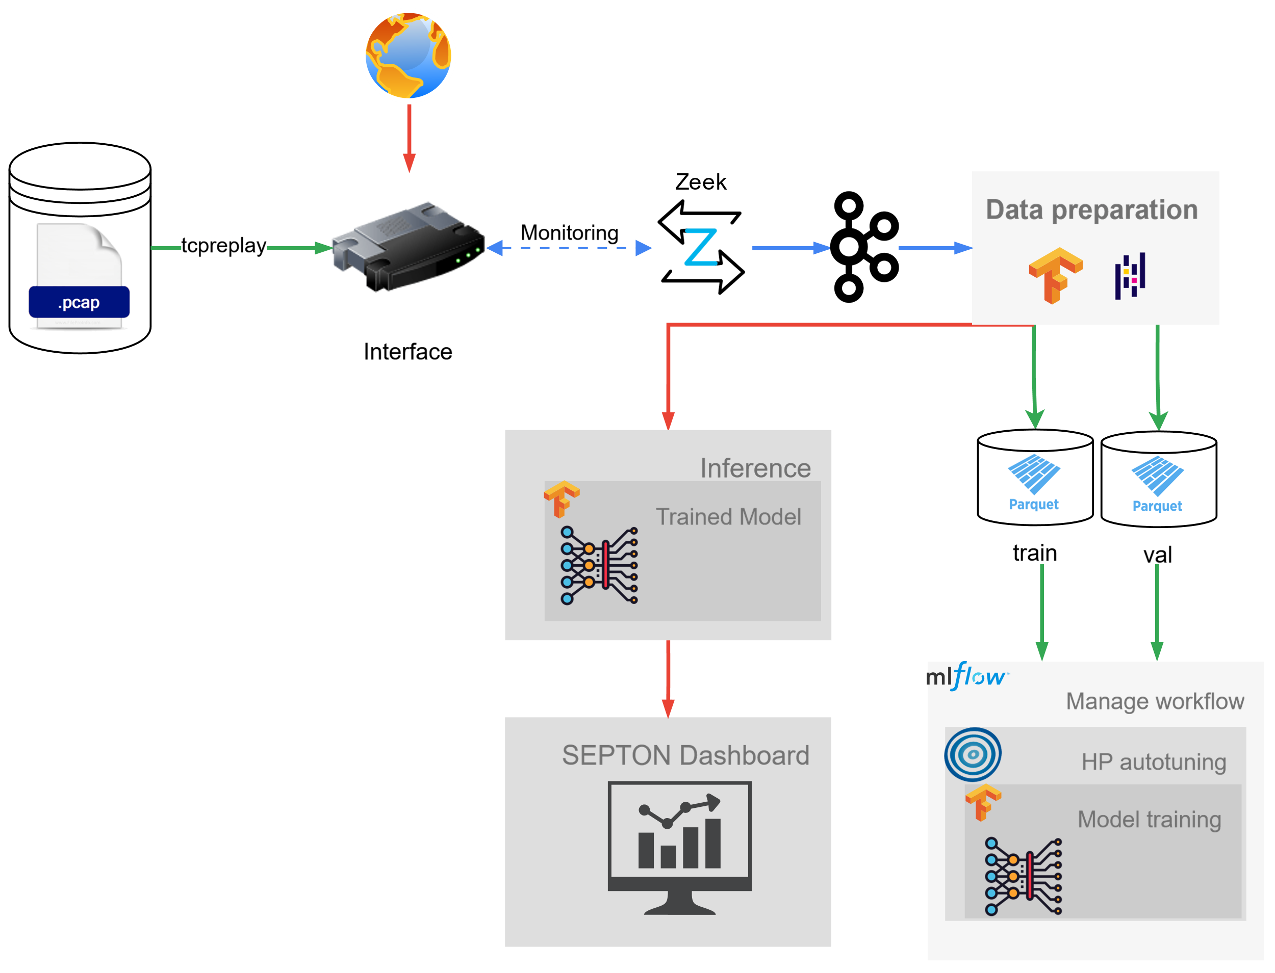
Technical Details
ZeekFlow: Network Anomaly Detection
Infili Technologies S.A.
Representation of data ingestion, training and inference pipelines.
Main tools used for implementation and development
Tool | Description
Zeek | Network analysis framework
Apache Kafka | Event streaming platform/broker
Tensorflow | Library for developing AI models
Optuna | Hyperparameter optimization framework
MLFlow | Monitoring ML development framework
Key features
Topic | Feature
Data Ingestion | Ingest pipeline with adaptors for diverse device traffic
AI | Joint training of specialized AutoEncoder and Classifier models
Security | Alert generation with context-aware severity assessment
Security Dashboard
Inference pipeline
Training pipeline
Common data ingestion pipeline

Slide 4
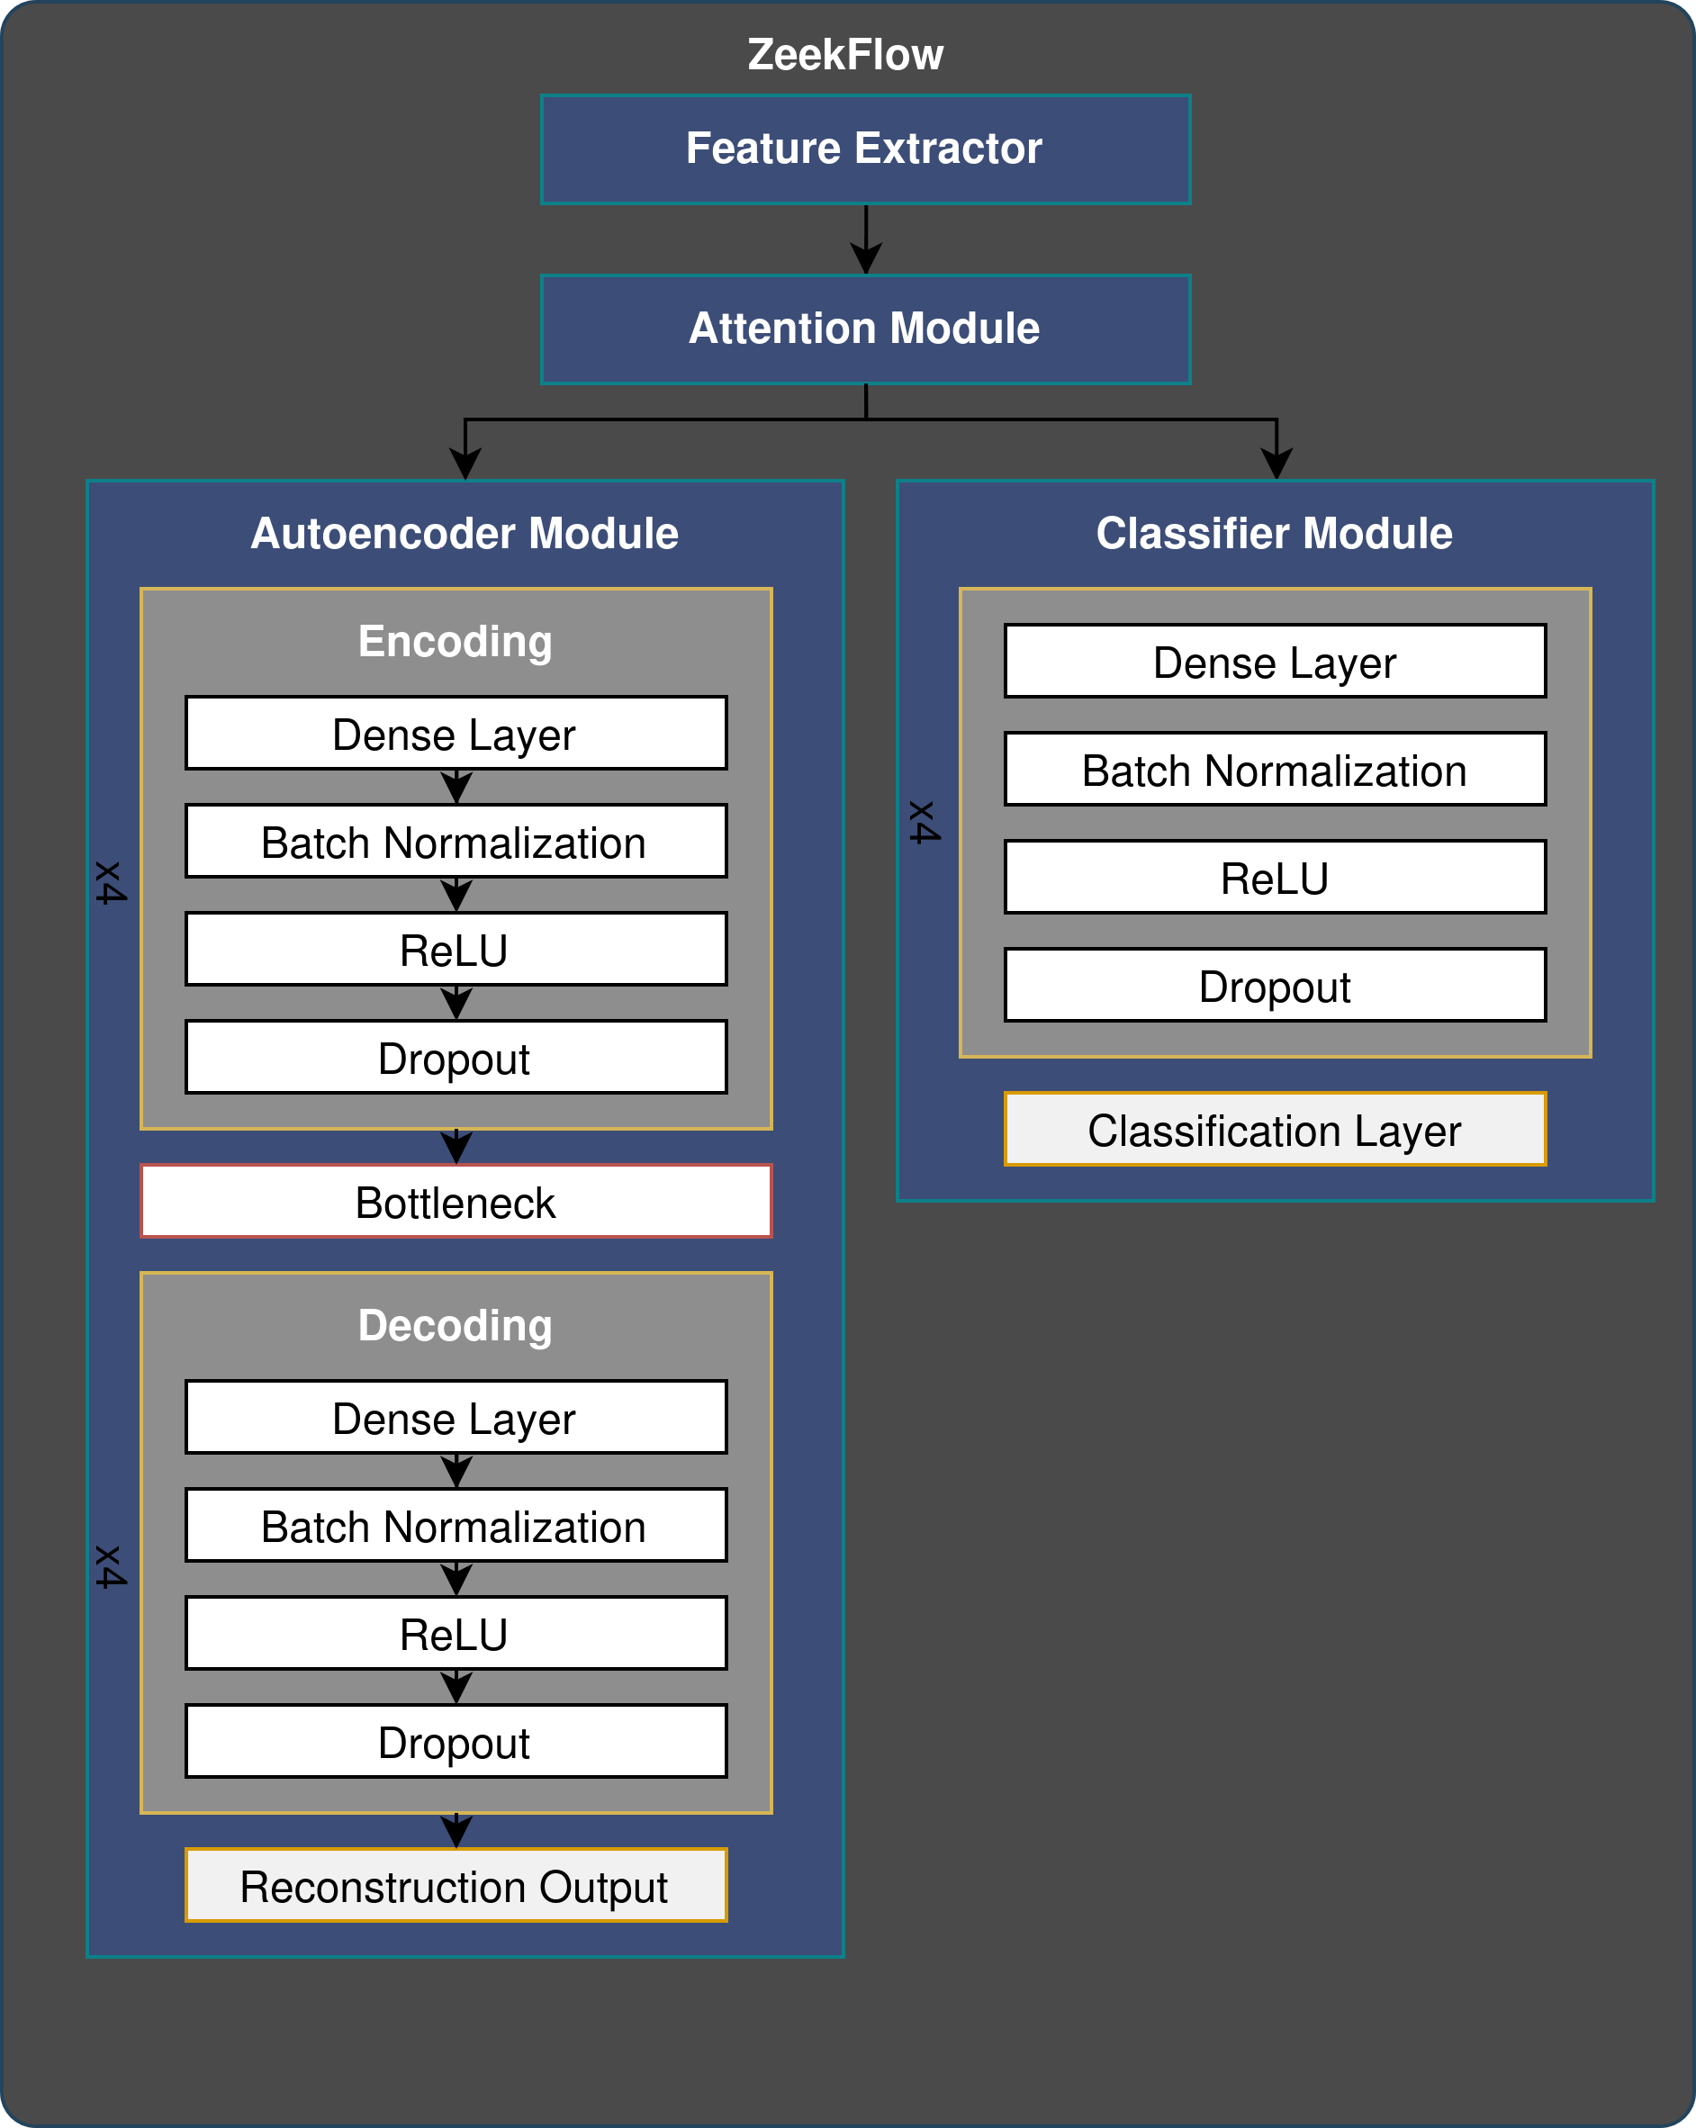
Technical Details
ZeekFlow: Network Anomaly Detection
Infili Technologies S.A.
Training Datasets
Model Architecture
Dataset | Description
IC-IOT-Dataset-2023 | A real-time dataset and benchmark for large-scale attacks in IoT environment
IC-IoMT-2024 | Attack Vectors in Healthcare Devices - A Multi-Protocol Dataset for Assessing IoMT Device Security
Hyper-parameters
Parameter | Value
Epochs | 200
Batch size | 4096
Learning rate | 0.001
Optimizer | Adam
Autoencoder loss | Mean Absolute Error
Classifier loss | Focal Cross-entropy
Autoencoder dims | [512, 256, 64, 32]
Classifier dims | [512, 256, 64, 32]
Dropout Rate | 0.25

